Slide 1
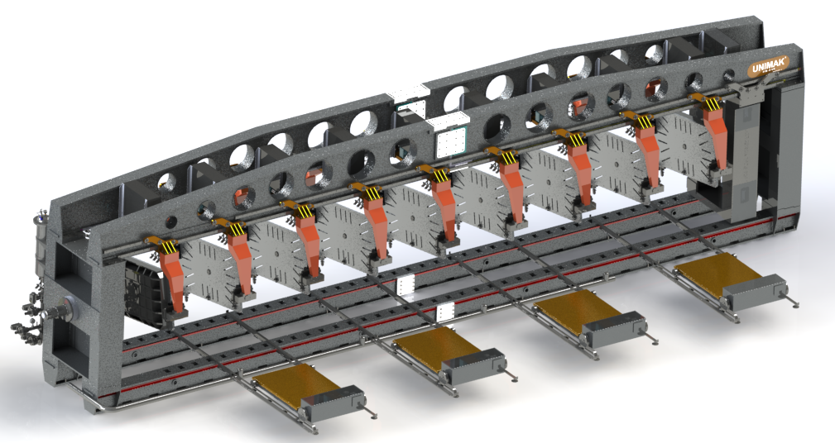
TYPE : ECM 8/12
BATTERY TYPE AUTOMATIC PRESSURE CASTING MACHINE
GENERAL MACHINE MASS

Slide 2
TECHNICAL PROPERTIES;
Width : ~4920mm
Length : ~14020mm
Height : ~3085mm
Weight : ~45 ton(Product purchase trolley group and moulds are not included)
Max. Mould size : 1000mmx1700mmx650mm
Max. mould weight : ~ 2ton
Max. mould number : 8 Horizontal or 12 Vertical
Energy : 380 V
Air : 16 bar
Air : 8 bar
Water (45°C) : 4 bar (min.)
Water (70°C) : 3-4 bar

Slide 3
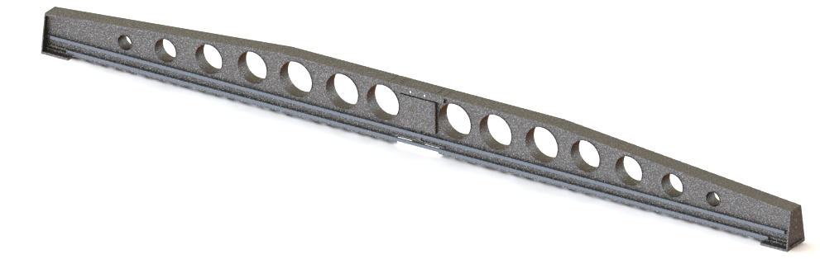
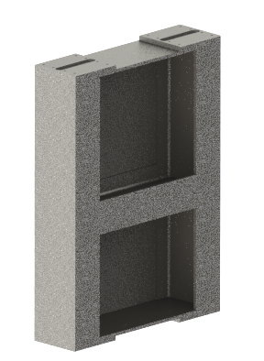
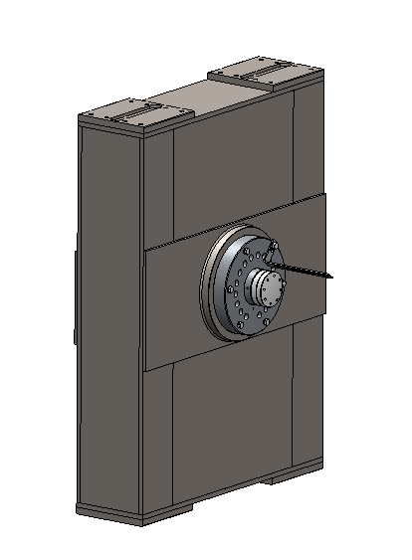
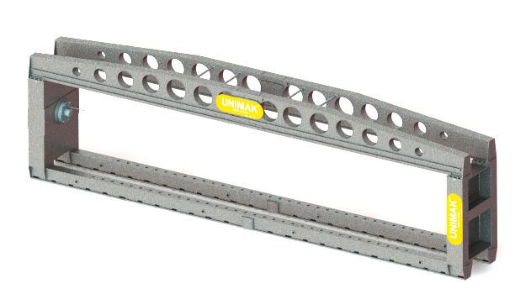
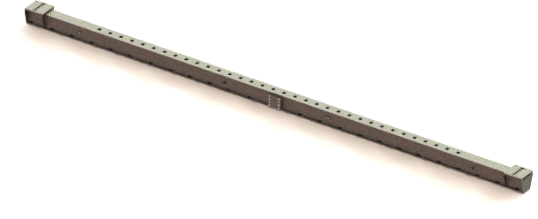
15051.01.00.000 CHASSIS GROUP:
Upper Beam(2 piece)
7 ton*2 (with safety factor 1.15)
Fixed Foot (1 piece)
2.5 ton (with safety factor 1.15)
Foot with Cylinder (1 piece)
5 ton (with safety factor 1.15)
Lower Beam(2 piece)
4.7 ton*2 (with safety factor 1.15)
Total Mass:30.9 ton (with safety factor 1.15)

Slide 4
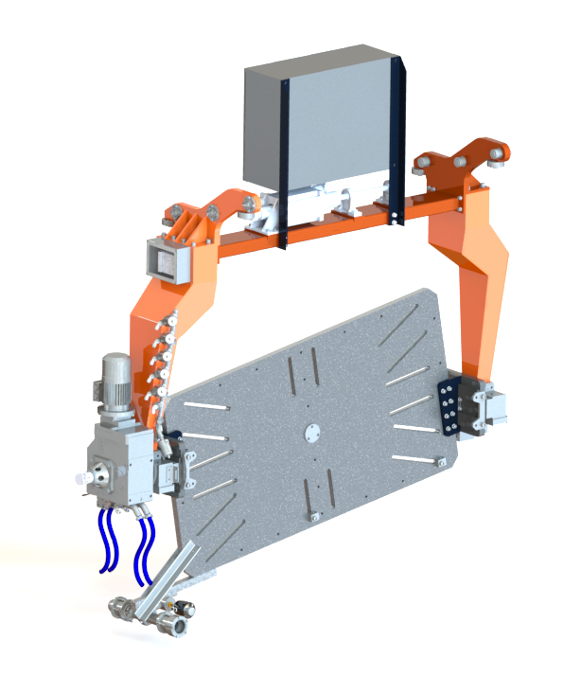
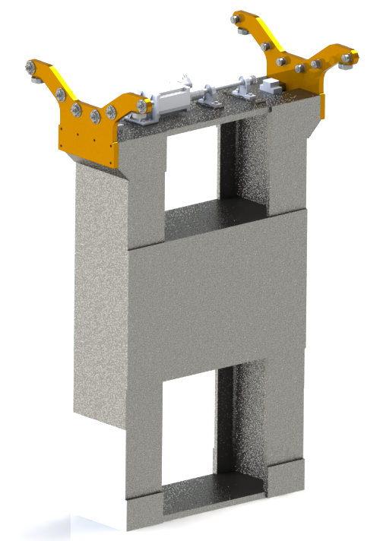
2. 15051.02.00.000 MOBILE FOOT:
3. 15051.03.00.000 ARM GROUP:
1.4 ton*9 (with safety factor 1.15)
3.8 ton (with safety factor 1.15)

Slide 5
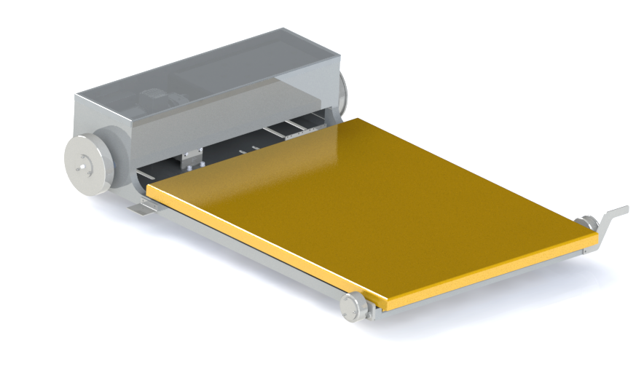
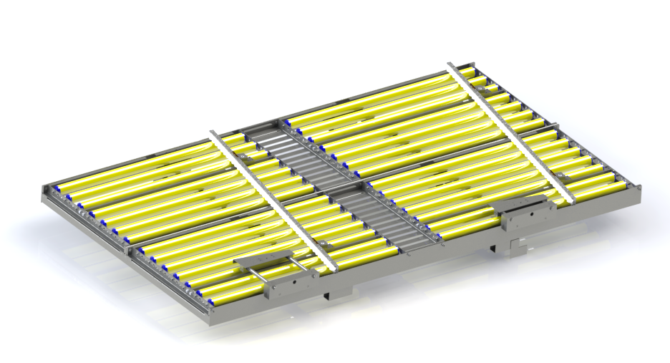
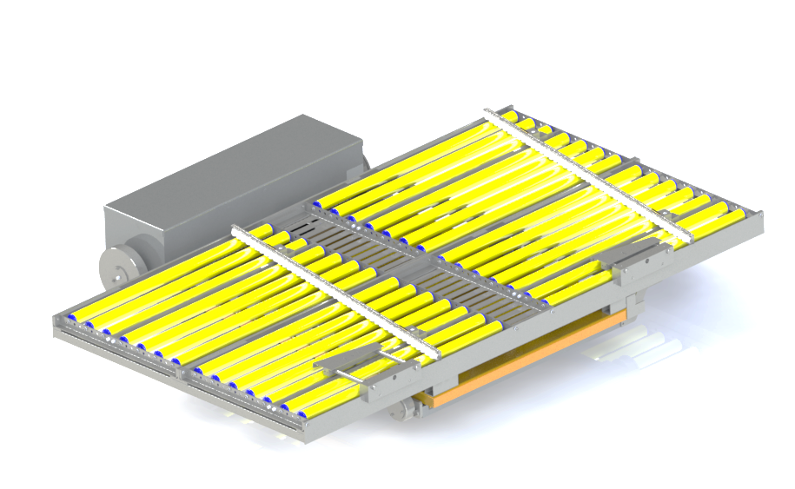
4. 15051.04.00.000 PRODUCT PICK UP TROLLEY GROUP:
Trolley Group
Demoulding Car
0.33 ton (with safety factor 1.15)
1.9 ton (with safety factor 1.15)
Total Mass:2,23 ton*4 (with safety factor 1.15)

Slide 6
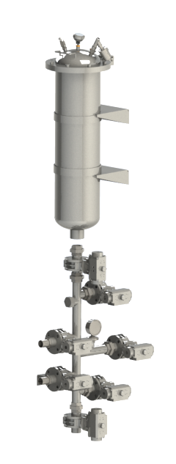
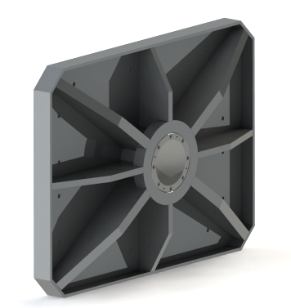
5. 15051.05.00.000 FLYWEIGHT HOLDER GROUP:
6. SLIP PRESSURE TANK GROUP:
Pressure Tank
0.1 ton (with safety factor 1.15)
Slip Line
0.1 ton (with safety factor 1.15)
Total Mass:0,9 ton*2 (with safety factor 1.15)

